Slide 1






Zeal IT Consultants
The SDLC

Slide 2


The SDLC Visualized

Slide 3
What is the SDLC?
The software development lifecycle, SDLC, is the process that transforms business needs into business value using code.

Slide 4
Four Phases
There are four main phases to the SDLC.
Discovery

Slide 5
Four Phases
There are four main phases to the SDLC.
Discovery > Design

Slide 6
Four Phases
There are four main phases to the SDLC.
Discovery > Design > Development

Slide 7
Four Phases
There are four main phases to the SDLC.
Discovery > Design > Development > Deployment

Slide 8

Discovery
The Discovery phase involves gathering and analyzing the requirements and goals for the project.
This includes conducting stakeholder interviews, surveys, and workshops to understand user needs, performing a feasibility study to assess the project's technical, operational, and economic viability, and documenting requirements through specifications, use cases, and user stories.
The goal is to ensure a clear understanding of what the project aims to achieve and its constraints.

Slide 9
Discovery Roles
Business Analysts: Gather and document requirements, conduct stakeholder interviews, and analyze business needs.
Project Managers / Product Owners: Plan and manage the project scope, timeline, and resources, ensuring alignment with business objectives.
Stakeholders: Provide input and feedback on requirements and expectations.
Subject Matter Experts (SMEs): Offer specialized knowledge and insights into specific areas of the project.
System Architects: Provide high-level technical insights and assess the feasibility of requirements.

Slide 10

Design
In the Design phase, detailed design specifications are created to guide the development process.
This involves defining the system architecture through high-level and detailed designs, creating user interface designs with wireframes, mockups, and prototypes, and documenting technical specifications like data models and algorithms.
The designs are reviewed and validated with stakeholders to ensure they meet the requirements and provide a blueprint for development.

Slide 11
Design Roles
UI/UX Designers: Create wireframes, mockups, and prototypes, ensuring a user-friendly interface and experience.
System Architects: Develop the overall system architecture, including hardware, software, and network design.
Technical Writers: Document technical specifications, data models, and design details.
Business Analysts: Ensure that the design meets the documented requirements and business goals.
Project Managers / Product Owners: Coordinate the design efforts and manage stakeholder reviews and approvals.

Slide 12
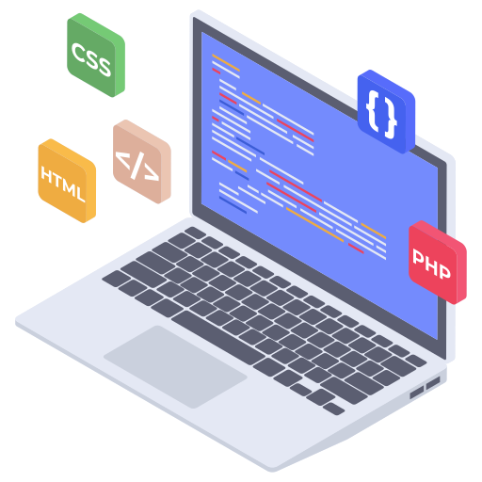
Development
During the Development phase, the system is built and integrated according to the design specifications.
This includes coding the software, conducting unit tests to ensure individual components function correctly, and using continuous integration practices to combine and test the components as a cohesive system.
The aim is to develop a working system that meets the design requirements and is ready for deployment.

Slide 13
Development Roles
Developers: Write code based on design specifications, develop software components, and perform unit testing.
Scrum Masters: Facilitate Agile practices, manage sprints, and ensure the development team stays on track.
Quality Assurance (QA) Testers: Conduct testing to ensure software quality and functionality.
Technical Leads: Oversee the technical development process, provide guidance, and resolve technical issues.
Database Administrators (DBAs): Manage database design, implementation, and maintenance.

Slide 14

Deployment
The Deployment phase focuses on releasing the system to the production environment and ensuring its operational readiness.
This involves planning the deployment strategy, setting up and configuring the production environment, and conducting final testing. The system is then released with accompanying release notes, user training, and documentation.
Post-deployment activities include monitoring the system for performance and issues, and providing ongoing support to address any problems that arise.

Slide 15
Deployment Roles
DevOps Engineers: Automate deployment processes, manage infrastructure, and ensure smooth deployment to production.
Release Managers: Plan and coordinate the release process, ensuring that all components are ready for deployment.
Site Reliability Engineers (SRE): Provide post-deployment support, monitor system performance, and address issues.
Quality Assurance (QA) Testers: Conduct final testing in the production-like environment to ensure readiness.
Technical Writers: Prepare release notes, user manuals, and documentation for end-users and support staff.

Slide 16
Navigating the SDLC

Slide 17

Navigating the SDLC

Slide 18
Navigating the SDLC

Slide 19
Navigating the SDLC

Slide 20
Navigating the SDLC

Slide 21
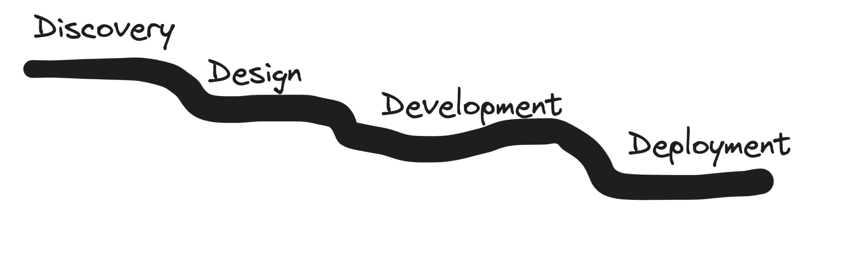
Navigating the SDLC

Slide 22

Navigating the SDLC

Slide 23
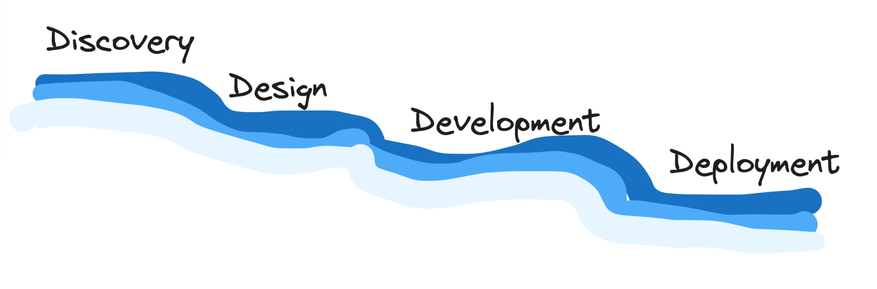
Navigating the SDLC

Slide 24

Waterfall ✨

Slide 25
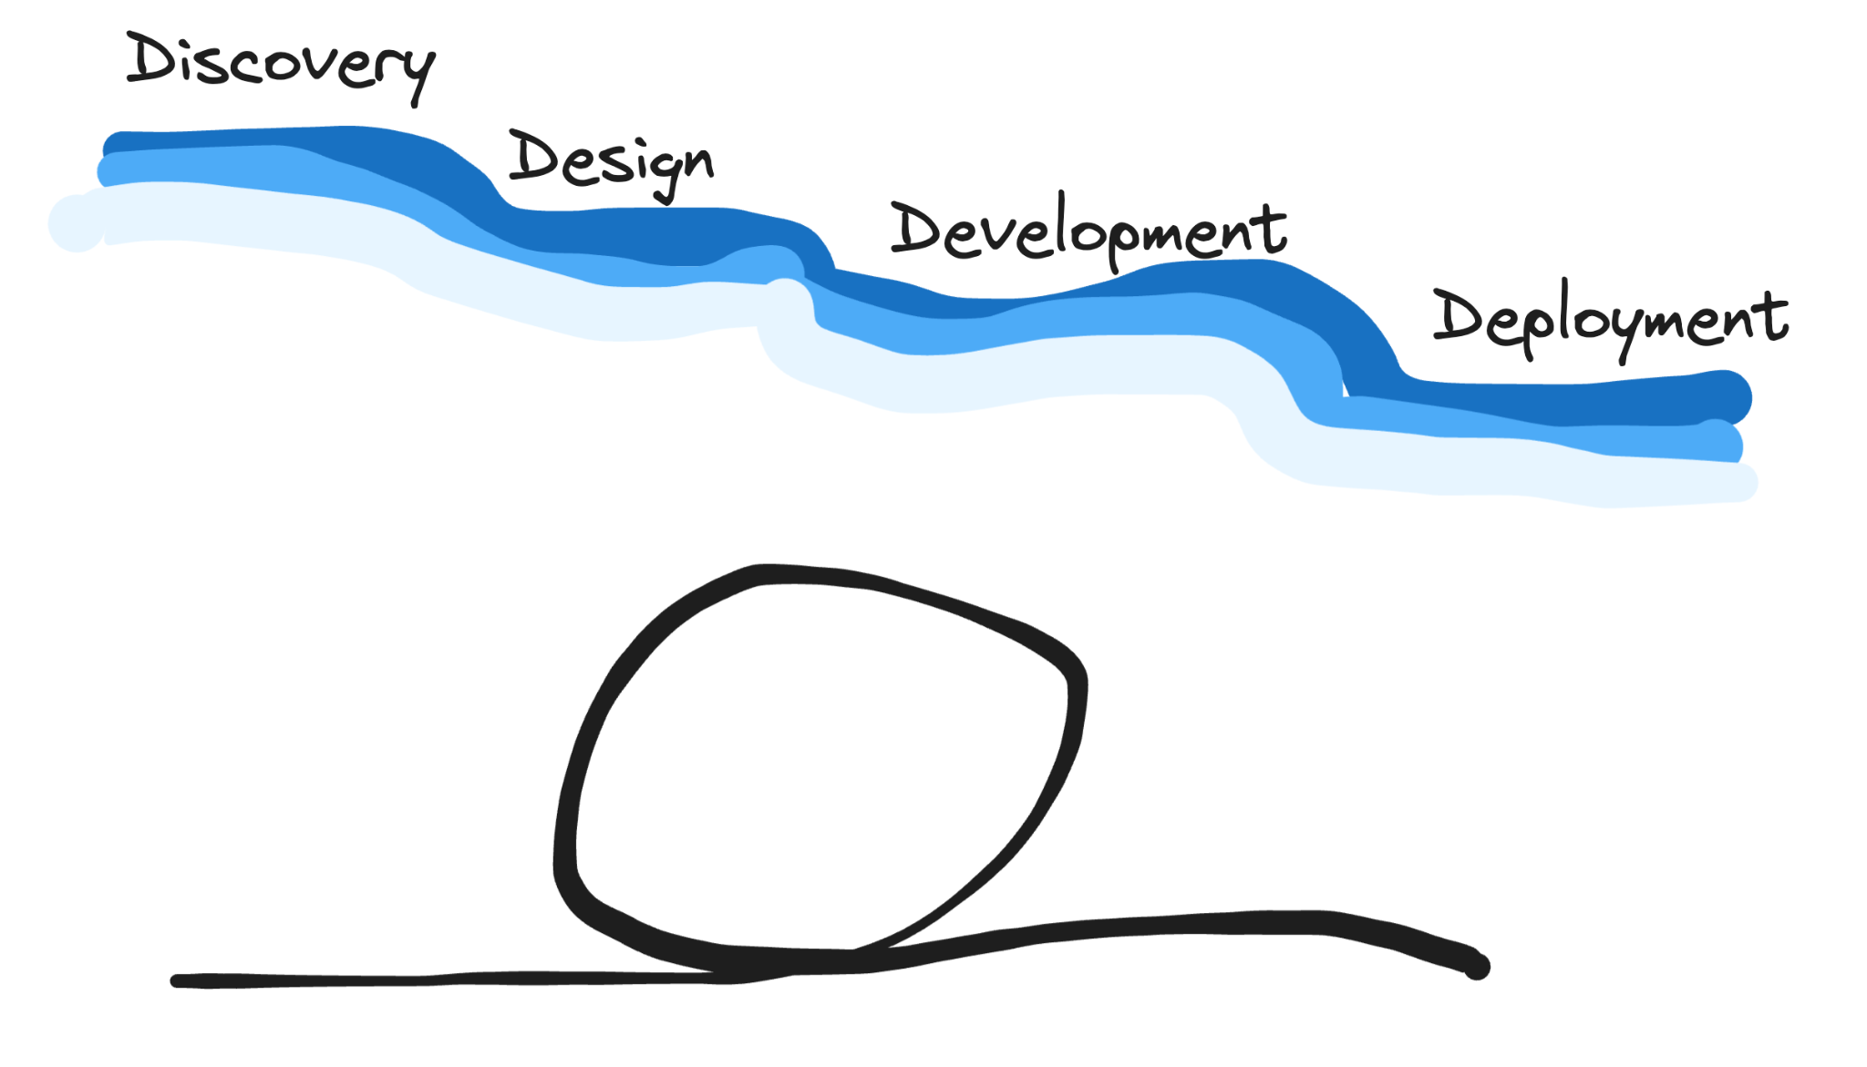
A Better Way

Slide 26
A Better Way

Slide 27

A Better Way

Slide 28

A Better Way

Slide 29

A Better Way

Slide 30

A Better Way

Slide 31
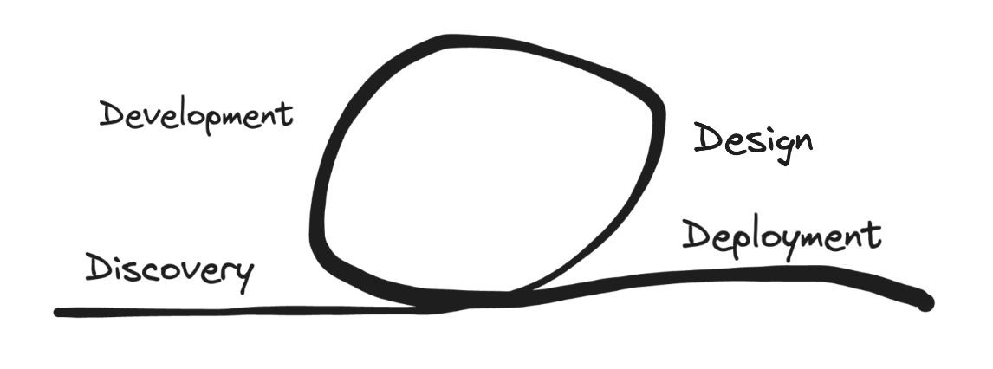
This looks familiar

Slide 32
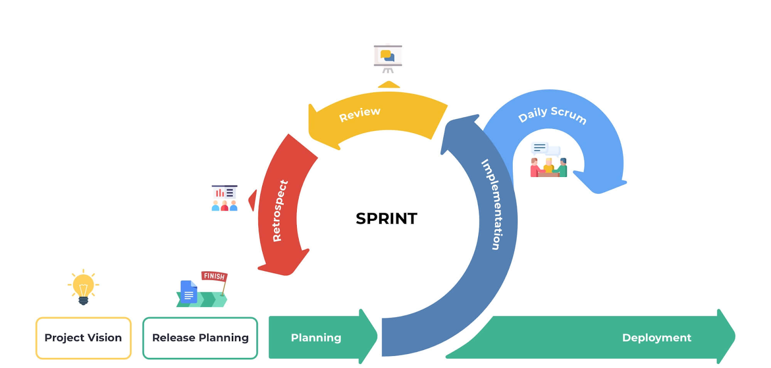
This looks familiar

Slide 33
Faster Cycles

Slide 34
Faster Cycles

Slide 35
Faster Cycles

Slide 36
Faster Cycles

Slide 37
Faster Cycles
3-6 Months

Slide 38
Faster Cycles
3-6 Months
6-8 Months

Slide 39
Faster Cycles
3-6 Months
6-8 Months
6-12 Months

Slide 40
Faster Cycles
3-6 Months
6-8 Months
6-12 Months
2-4 Months

Slide 41
Faster Cycles
3-6 Months
6-8 Months
6-12 Months
2-4 Months
2 Weeks

Slide 42
Faster Cycles
3-6 Months
6-8 Months
6-12 Months
2-4 Months
2 Weeks
2 Weeks

Slide 43
Faster Cycles
3-6 Months
6-8 Months
6-12 Months
2-4 Months
2 Weeks
2 Weeks
2 Weeks

Slide 44

Anyone afraid of heights?

Slide 45

Anyone afraid of heights?

Slide 46
Faster Cycles
3-6 Months
6-8 Months
What happens if I fail here?
6-12 Months
2-4 Months
2 Weeks
2 Weeks
2 Weeks

Slide 47
Faster Cycles
3-6 Months
6-8 Months
What happens if I fail here?
6-12 Months
2-4 Months
2 Weeks
2 Weeks
2 Weeks

Slide 48
Better Every Day
An important concept in software engineering as well as agile is Continuous Improvement.
Our goal is to deliver value frequently, reliably, and safely to those that rely on us.

Slide 49
When do I get value?
3-6 Months
6-8 Months
Here, I get value after two years.
6-12 Months
2-4 Months
2 Weeks
2 Weeks
2 Weeks

Slide 50
When do I get value?
3-6 Months
6-8 Months
Here, I get value every two weeks.
6-12 Months
2-4 Months
2 Weeks
2 Weeks
2 Weeks

Slide 51
Zeal IT Consultants
Whatever you do,
do it with Zeal.

